Slide 1

BLUETOOTH HOME AUTOMATION USING 8051
Done by : RAMPRASAATH R N[RA2211004010417],
PRAGADESHWARAN[RA2211004010404],
JEROME JULIAN J[RA2211004010411].

Slide 2
Introduction
Bluetooth home automation using an 8051 microcontroller is a system that allows users to control household appliances wirelessly via Bluetooth. The 8051 microcontroller acts as the central unit, interfacing with various devices like lights, fans, and locks. A Bluetooth module, such as HC-05, connects to the microcontroller, receiving commands from a smartphone or other Bluetooth-enabled devices. When a command is sent, the microcontroller processes it and activates or deactivates the connected appliances. This system offers a low-cost, easy-to-implement solution for automating home devices.

Slide 3
Objective
The objective of Bluetooth home automation using the 8051 microcontroller is to revolutionize home living by providing a seamless, wireless control system for household appliances. This project aims to create a robust, scalable solution that integrates Bluetooth technology with the 8051 microcontroller to enable real-time, remote operation of lights, fans, security systems, and more through a simple smartphone interface. By leveraging the reliability of the 8051 microcontroller and the widespread use of Bluetooth, this system enhances convenience, energy management, and security, laying the groundwork for modern smart homes. The overarching goal is to simplify home automation, making it accessible, customizable, and adaptable to future technological advancements, driving the evolution of everyday living spaces into intelligent environments.

Slide 4
System Components
The system components for Bluetooth home automation using the 8051 microcontroller typically include:
8051 Microcontroller: The central processing unit that controls and processes signals to manage home appliances.
Bluetooth Module (HC-05/HC-06): Facilitates wireless communication between the smartphone and the microcontroller.
Smartphone: Acts as the user interface, sending control commands to the Bluetooth module.
Relay Module: Electrically isolates and controls high-power devices (e.g., lights, fans) using signals from the microcontroller.
Power Supply Unit: Provides the required voltage and current to the microcontroller and other components.
Home Appliances: Devices like lights, fans, or locks, controlled by the system via relays.

Slide 5
Working Principle
The working principle of Bluetooth home automation using the 8051 microcontroller is simple: A smartphone sends control commands via Bluetooth to the system's Bluetooth module (HC-05). The 8051 microcontroller receives these commands and processes them. Based on the command received, the microcontroller activates or deactivates the corresponding relays, which in turn control the connected appliances like lights, fans, or locks. This allows users to wirelessly control their home devices in real-time.

Slide 6
Use Cases
Remote Light Control: Users can turn lights on/off or adjust brightness wirelessly from their smartphones.
Fan Speed Regulation: Control fan speed remotely for better comfort and energy efficiency.
Appliance Scheduling: Set timers to automatically turn appliances on or off, improving energy management.
Smart Door Locking: Remotely lock or unlock doors via Bluetooth for enhanced security and convenience.
Garage Door Automation: Open or close the garage door without getting out of the car, simply by using a phone.
Energy Monitoring: Monitor and control high-energy devices to reduce power consumption.
Customizable Scenes: Pre-set multiple appliances to turn on/off together, such as a "Good Morning" or "Movie Night" mode.

Slide 7
Merits
Wireless Convenience: Enables remote control of home appliances via smartphone, eliminating the need for manual operation.
Cost-Effective: Utilizes affordable components like the 8051 microcontroller and Bluetooth modules, making home automation accessible.
Energy Efficiency: Allows users to schedule and manage devices, reducing unnecessary power consumption and optimizing energy use.

Slide 8
Demerits
Limited Range: Bluetooth's range is relatively short, typically up to 10 meters, restricting control to nearby areas.
Device Pairing Issues: Connectivity can be disrupted due to pairing problems or interference from other wireless devices.
Lack of Internet Access: Without internet connectivity, the system cannot be controlled remotely from outside the Bluetooth range, limiting its functionality compared to Wi-Fi-based systems.

Slide 9
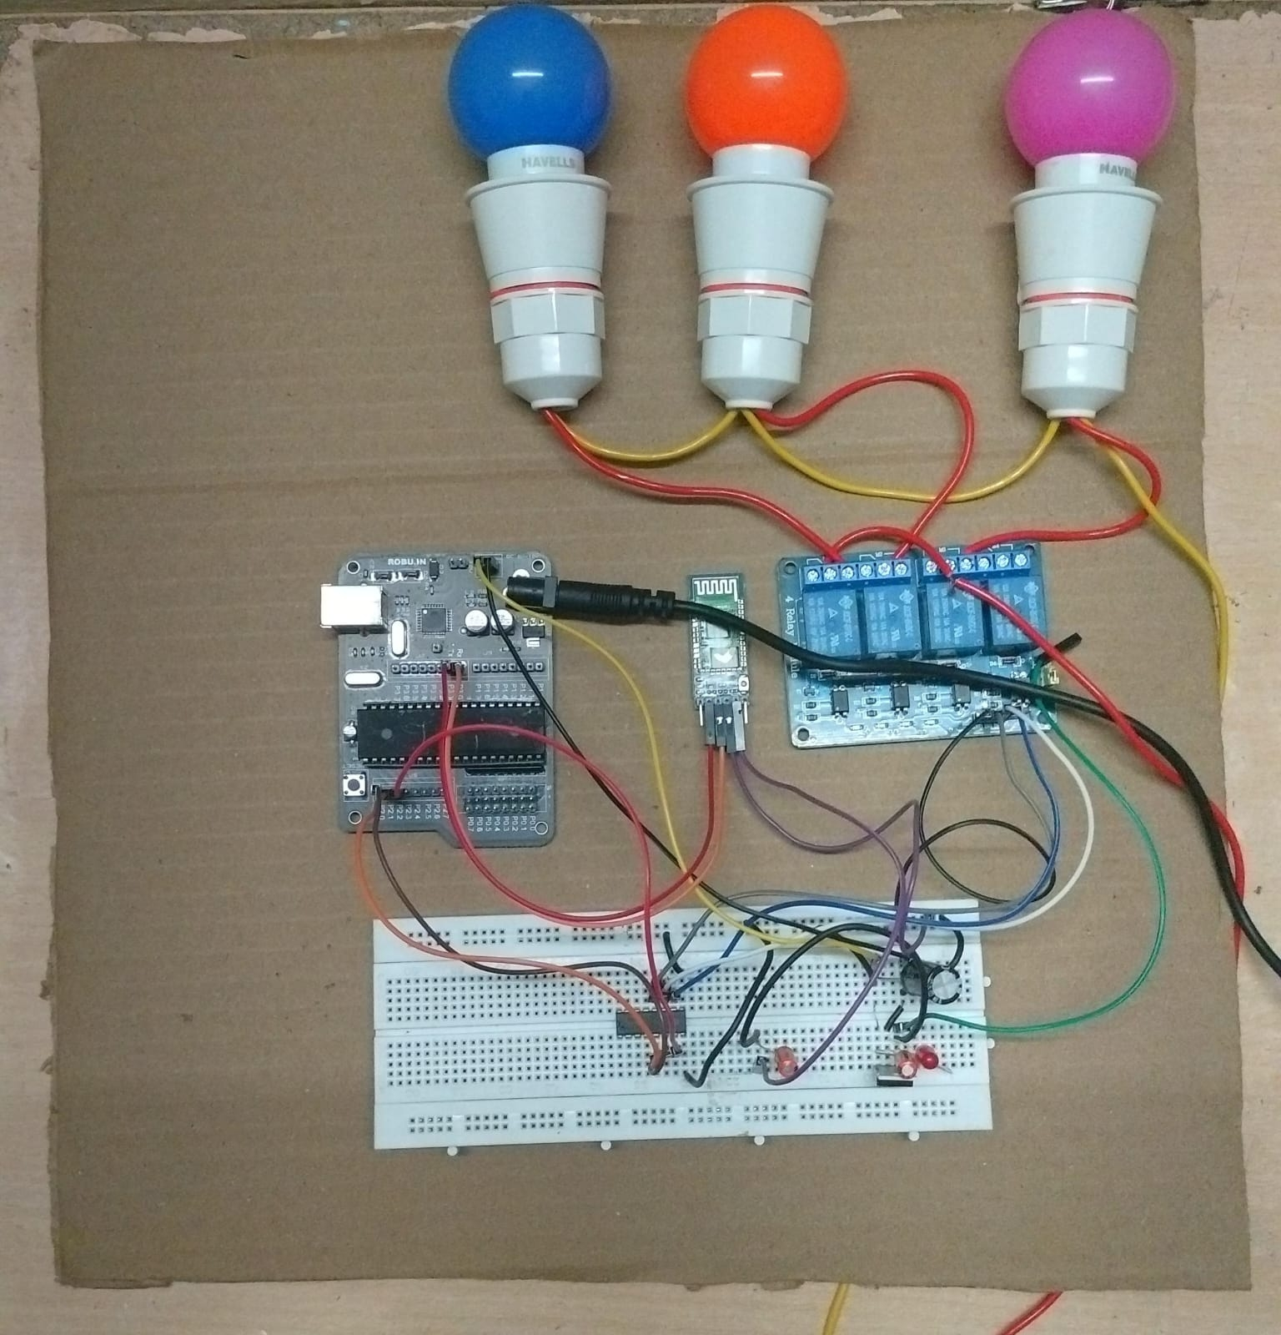
Project Photo

Slide 10
Conclusion & Future Scope
Bluetooth home automation using the 8051 microcontroller provides an affordable, user-friendly solution for wireless control of home appliances. It enhances convenience and energy efficiency, making it ideal for small-scale smart homes.
Future developments could include integrating Wi-Fi or IoT for remote control from anywhere, expanding automation features, and incorporating AI for predictive control and enhanced user experience. This would make the system more versatile, scalable, and aligned with the evolving smart home technology landscape.

